Slide 1
Large-scale HPC Modelling Simulation Perspectives on Neuromorphic computing
Thomas E. Potok, PhD
Data and AI Section Head
Oak Ridge National Laboratory

Slide 2
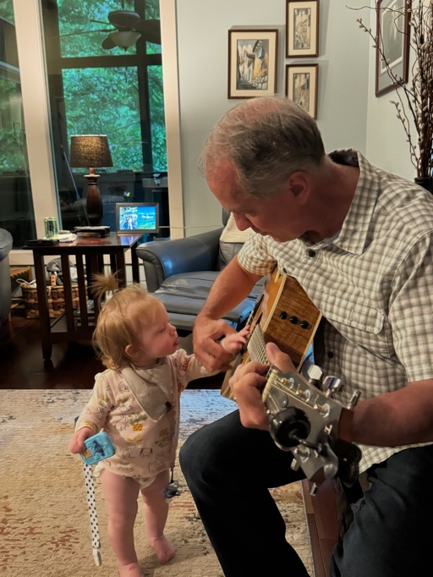
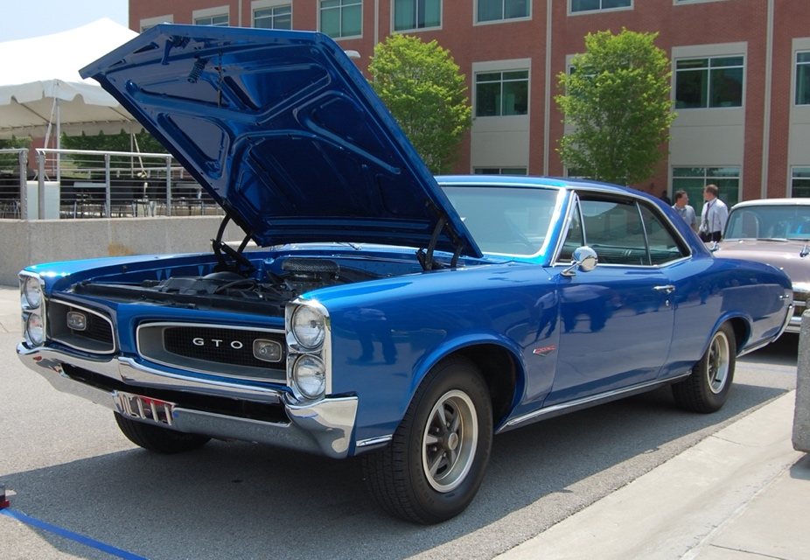
About me
Data and AI Section head, five groups, 50+ researchers and engineers, $15M budget
Research in intelligent agents, machine learning, swarming technology, genetic algorithms, deep learning on high performance, quantum, and neuromorphic computers.
130+ research papers, 17 issued patents Battelle Distinguished Inventor, 5 R&D 100 awards, 3 Gordon Bell Finalists
Co-founded VorText acquired by Covenant Healthcare, awarded Federal Laboratory Consortium Awards for Excellence in Technology Transfer
Many year of work with Knoxville Internet Crimes against Children task force
Married 36 years, a son in the US Navy, and a daughter (UT Grad) who works at ORNL
Love/Hate relationship with my 1966 GTO (since 1980)

Slide 3













AI/ML Background
Army
NSA
SOCOM
FBI
NRO
DIA
Marines
Navy
CIA
DHS
DOE
NCTC
OSD
MDA
Evolutionary Algorithms
Generative AI
Neuromorphic Computing
Swarm Intelligence
X. Cui, J. Beaver, J. S. Charles, and T. Potok, “The GPU Enhanced Parallel Computing for Large Scale Data Clustering”, Accepted for Book Chapter of GPU Computing Gems 2010, Springer
Machine
Learning
R. M. Patton, B. G. Beckerman, T. E. Potok, “Analysis and Classification of Mammography Reports Using Maximum Variation Sampling”, Genetic and Evolutionary Computation: Medical Applications published by Wiley, January 2011, ISBN: 978-0-470-74813-8.
A.R. Hurson, E. Jean, M. Ongtang, X. Gao, Y. Jiao, and T. E. Potok, “Recent advances in mobile agent-oriented applications”. Mobile Intelligence: Mobile Computing and Computational Intelligence, John Wiley & Sons, 2009.
Y. Jiao, A.R. Hurson, and T.E. Potok, “Mobile agent-based information systems and security,” The Encyclopedia of Information Science and Technology, 2nd ed.
Knowledge Graphs
Intelligent Agents
X. Cui, and T. Potok, “Swarm Intelligence in Document Clustering”, book chapter in Handbook of Research on Text and Web Mining Technologies, Idea Group Inc. 2008, USA.
X. Cui, R. M. Patton, J. Treadwell, and T. E. Potok, “Particle Swarm Based Collective Searching Model for Adaptive Environment,” book chapter in Springer’s Studies in Computational Intelligence (SCI), Proceedings of 2nd Workshop on Nature Inspired Cooperative Strategies for Optimization, November, 2007
J. S. Charles, T. E. Potok, R. M. Patton, and X. Cui, “Flocking-based Document Clustering on the Graphics Processing Unit,” book chapter in Springer’s Studies in Computational Intelligence (SCI), Proceedings of 2nd Workshop on Nature Inspired Cooperative Strategies for Optimization, November, 2007
B. G. Sumpter, R. K. Vasudevan, T. Potok, and S. V. Kalinin, “A bridge for accelerating materials by design,” npj Comput. Mater. 1, 15008, 2015.
X. Cui and T.E. Potok, “Document Clustering Analysis based on Hybrid PSO+K-means Algorithm,” Special Issue on Efficient Heuristics for Information Organization in the Journal of Computer Science, 2005.
Y. Zhang, F. Mueller, X. Cui, and T. E. Potok, “Data-Intensive Document Clustering on GPU Clusters”, Accepted for Journal of Parallel and Distributed Computing, 2010
X. Cui, J. Gao, and T. E. Potok, “A Flocking Based Algorithm for Document Clustering Analysis,” Journal of System Architecture, Special issue on Nature Inspired Applied Systems, 2006.
Evolutionary Algorithms
Natural Language Processing
X. Cui and T. E. Potok, “A Bio-inspired Clustering Approach for Dynamic Document Distributed Analysis”, International Journal of Computational Intelligence Theory and Practice, 2006, ISSN: 0973-5267.
R. Patton, T. Potok and B. Worley, “Discovery & Refinement of Scientific Information via a Recommender System”, The Second International Conference on Advanced Communications and Computation, 2012, 31–35.
X. Cui, L. Pullum, J. Treadwell, R. M. Patton, and T. E. Potok, “A Stigmergy Approach for Open Source Software Developer Community Simulation”, Symposium on Social Computing Applications (SCA09), September, 2009, Vancouver, Canada
R. M. Patton, B. G. Beckerman, T. E. Potok, and J. N. Treadwell, “Genetic Algorithm for Analysis of Abdominal Aortic Aneurysms in Radiology Reports”, Genetic and Evolutionary Computation Conference, July 2010.
Y. Zhang, F. Mueller, X. Cui, and T. E. Potok, “Large-Scale Multi-Dimensional Document Clustering on GPU Clusters”, IEEE International Parallel & Distributed Processing Symposium (IPDPS 2010), April, 2010
Graph Neural Networks
Y. Zhang, F. Mueller, X. Cui, and T. E. Potok, “ScalaExtrap: Trace-Based Communication Extrapolation for SPMD Programs”, accepted to Parallel Architectures and Compilation Techniques (PACT), Vienna, Austria, 2010
Y. Zhang, F. Mueller, X. Cui, T. E. Potok, “A Programming Model for Massive Data Parallelism with Data Dependencies”, The Eighteenth International Conference on Parallel Architectures and Compilation Techniques (PACT), September, 2009, Raleigh, NC, USA
Y. Zhang, F. Mueller, X. Cui, and T. E. Potok, “GPU-Accelerated Text Mining,” Workshop on Exploiting Parallelism using GPUs and other Hardware-Assisted Methods, March, 2009, Seattle, Washington, USA
R. M. Patton, J. N. Treadwell, R. A. Kerekes, and T. E. Potok, “Discovery, Analysis, and Characteristics of Event Impacts”, The 11th International Conference on Information Fusion, July 2008.
J. M. Beaver, X. Cui, J. St. Charles, and T. E. Potok, “Modeling Success in FLOSS Project Groups”, Proceedings of the Predictor Models in Software Engineering (PROMISE) 2009, May, 2009, Vancouver, Canada
X. Cui, J. M. Beaver, J. St. Charles, and T. E. Potok, “Dimensionality Reduction for High Dimensional Particle Swarm Clustering,” Proceedings of the IEEE Swarm Intelligence Symposium, September, 2008, St. Louis, USA
E. Jean, Y. Jiao, A. Hurson, and T. E. Potok, “SAS: A secure aglet server,” In Proc. of Computer Security Conference 2007, available online at http://computersecurityconference.com/Papers2007/CSC2007Jean.doc., 2007.
Publication
Mining
M. Ongtang, A. Hurson, Y. Jiao, and T. E. Potok, “Agent-based transactions management for mobile multidatabase,” In Proc. of the 3rd IEEE International Conference on Wireless and Mobile Computing, Networking and Communications, (WiMob’07), 2007.
P. Yan, Y. Jiao, A.R. Hurson, and T.E. Potok, “Semantic-based information retrieval of biomedical data,” In Proc. of the 21st Annual ACM Symposium on Applied Computing –Semantic-Based Resource Discovery, Retrieval and Composition (RDRC), pp.1700-1704, 2006.
Quantum Machine Learning
Networks of computers
Cluster computers
GPUs
HPC
Hybrid HPC CPU/GPU
Neuromorphic
Quantum
2007 R&D 100 Piranha
2013 R&D 100 DTHSTR
2018 Gordon
Bell Finalists
R&D 100
MENNDL
2020 Gordon
Bell R&D100 Finalists
SNAPSHOT
2022 Gordon
Bell Finalist
R&D100
SNAPSHOT and Gremlin
2023 R&D100
SuperNeuro
2024 R&D100
MAQ: Machine Learning on Adiabatic Quantum Computers

Slide 4
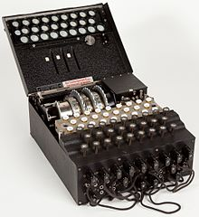

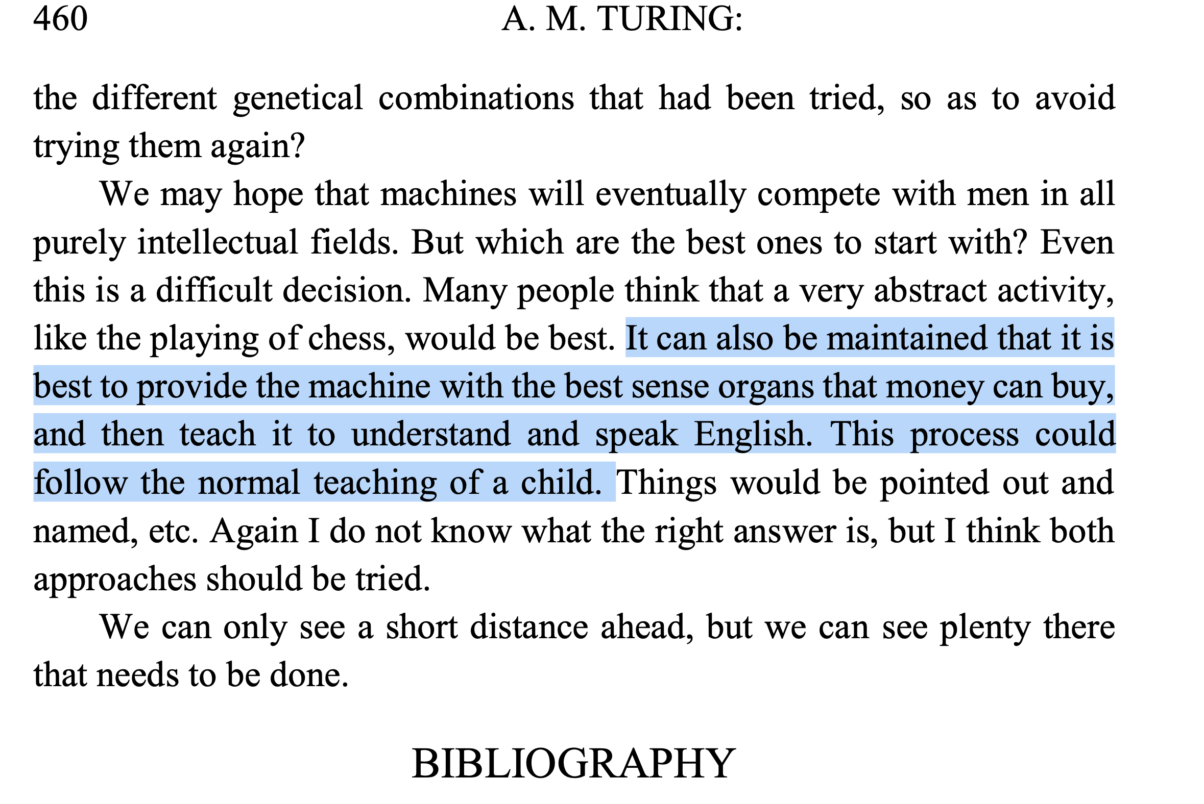
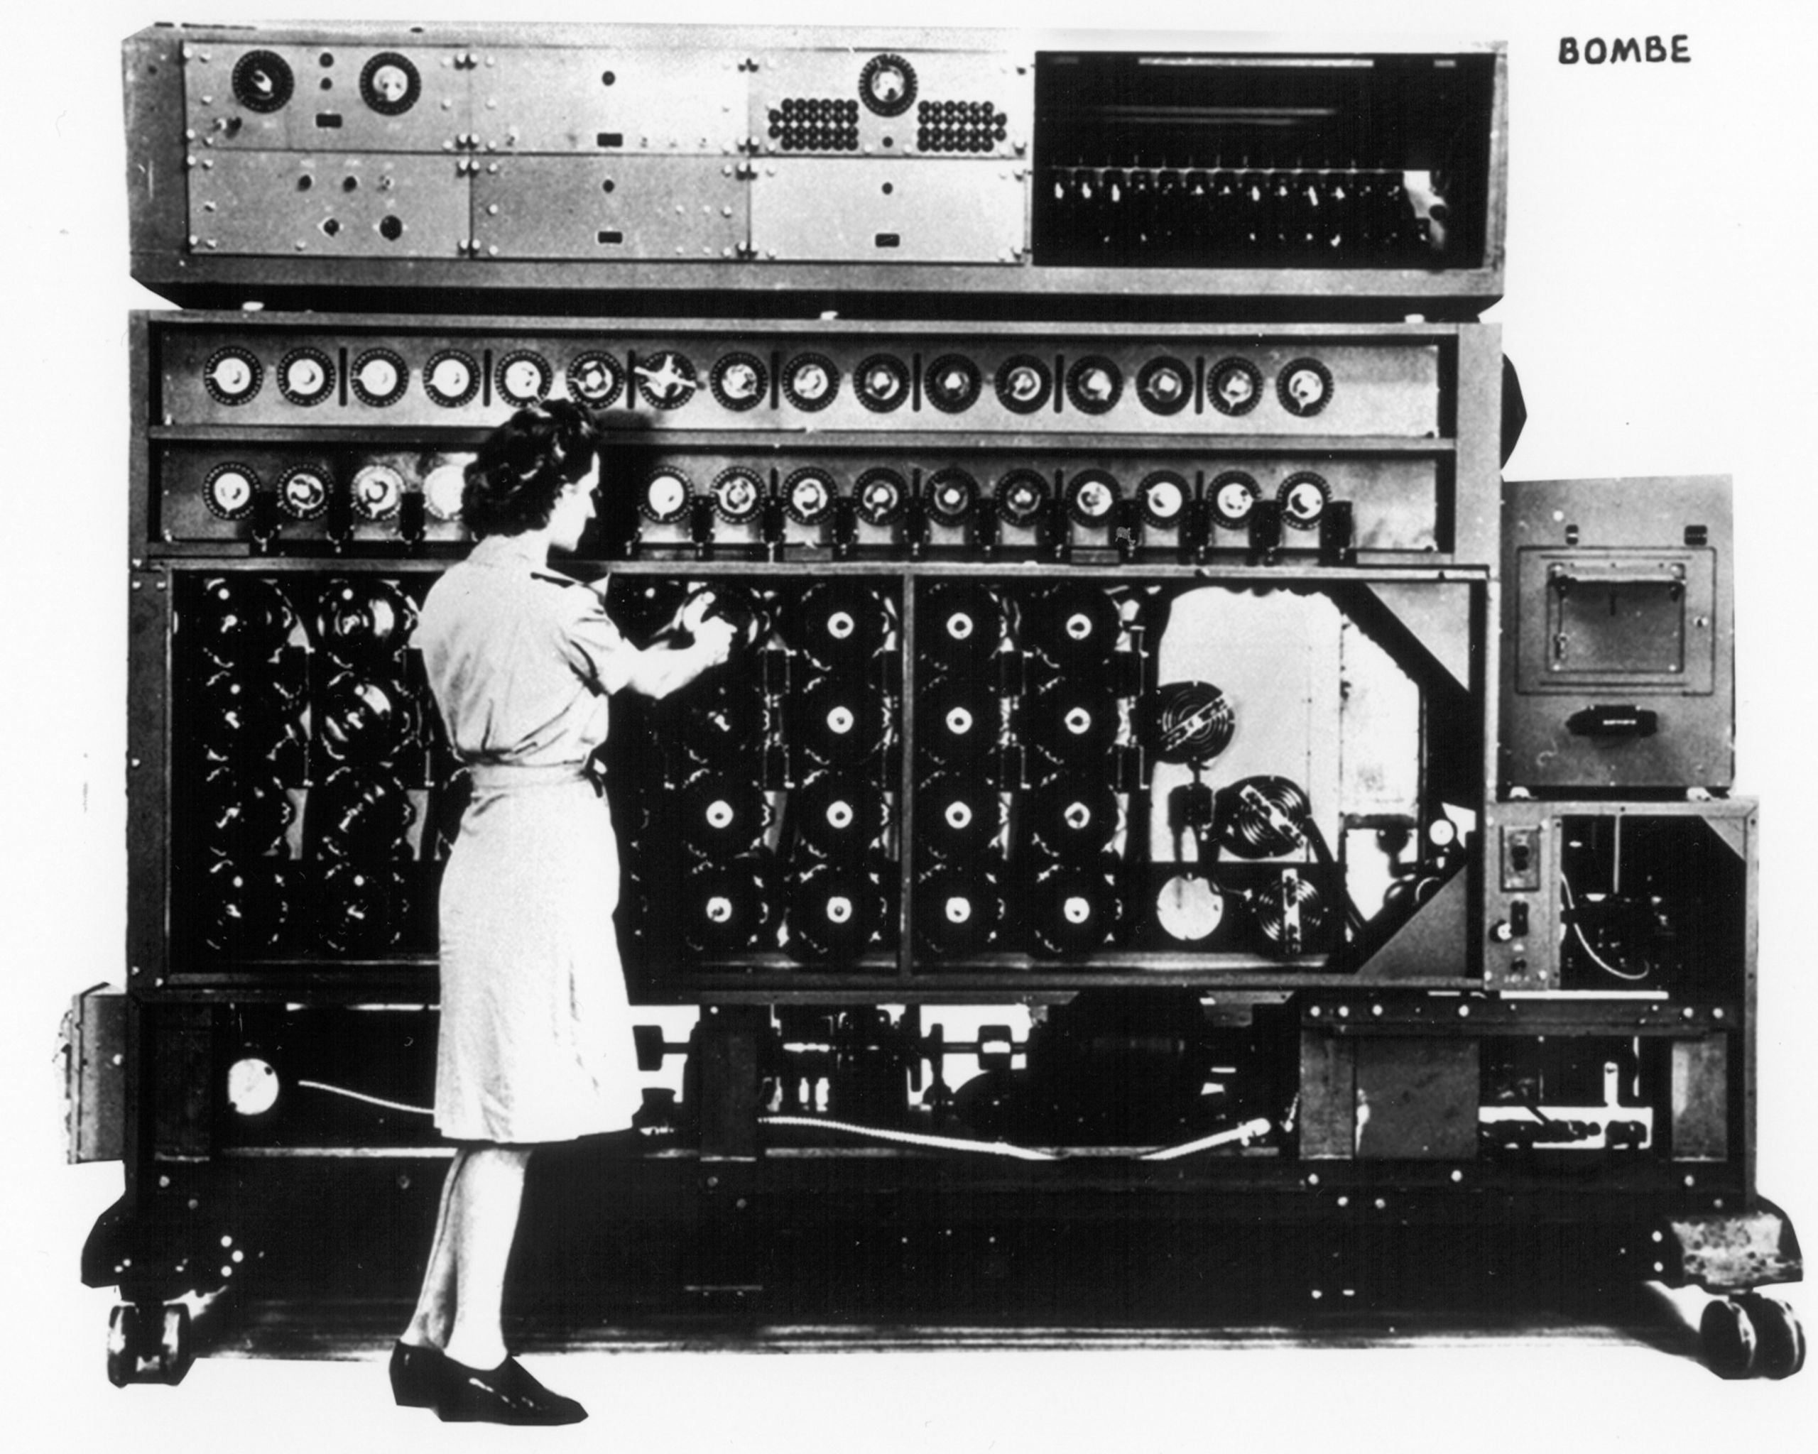
Thinking machines and language
…
A. M. TURING, I.—COMPUTING MACHINERY AND INTELLIGENCE, Mind, Volume LIX, Issue 236, October 1950, Pages 433–460, https://doi.org/10.1093/mind/LIX.236.433

Slide 5
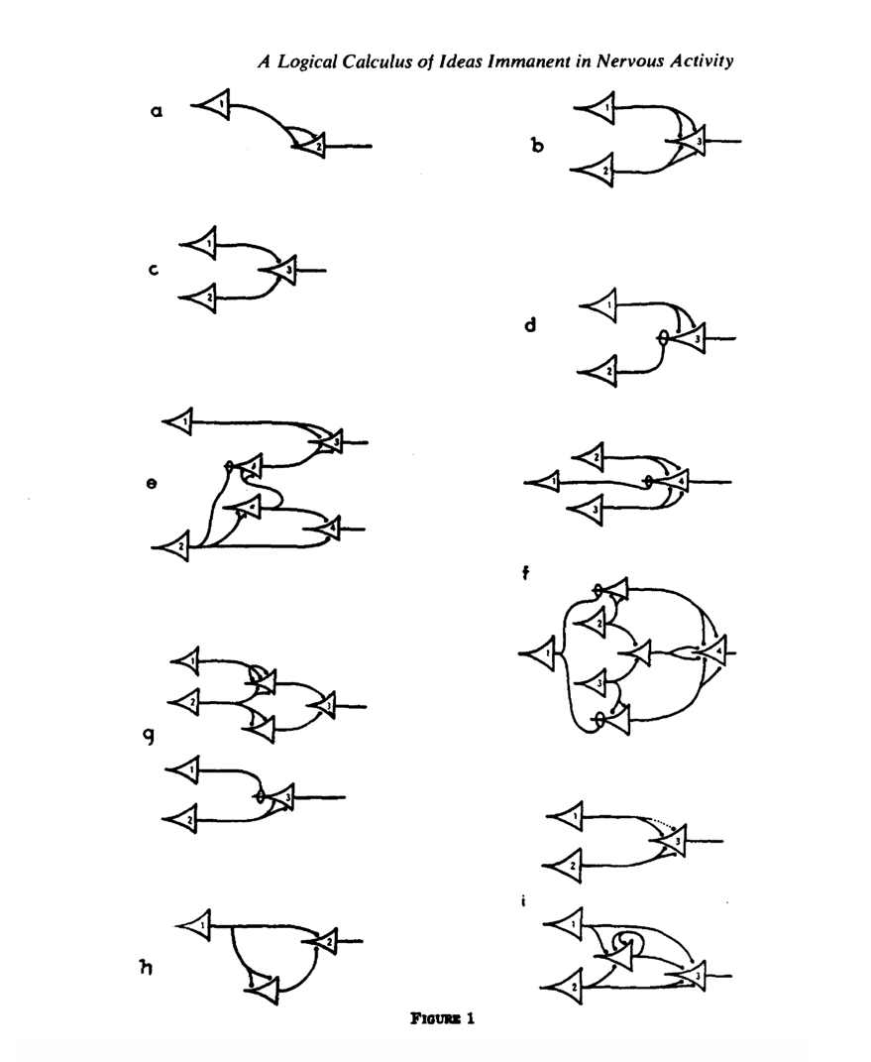
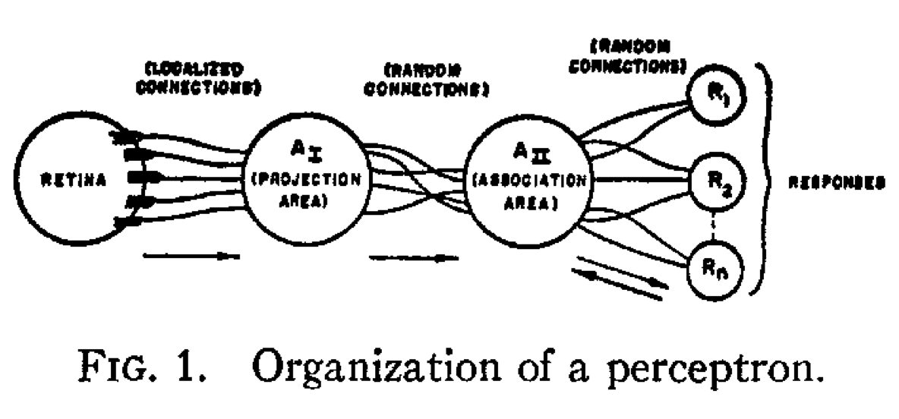
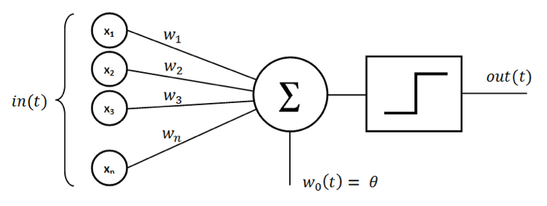
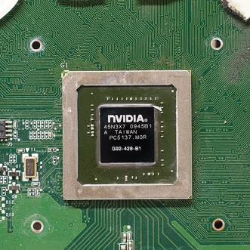
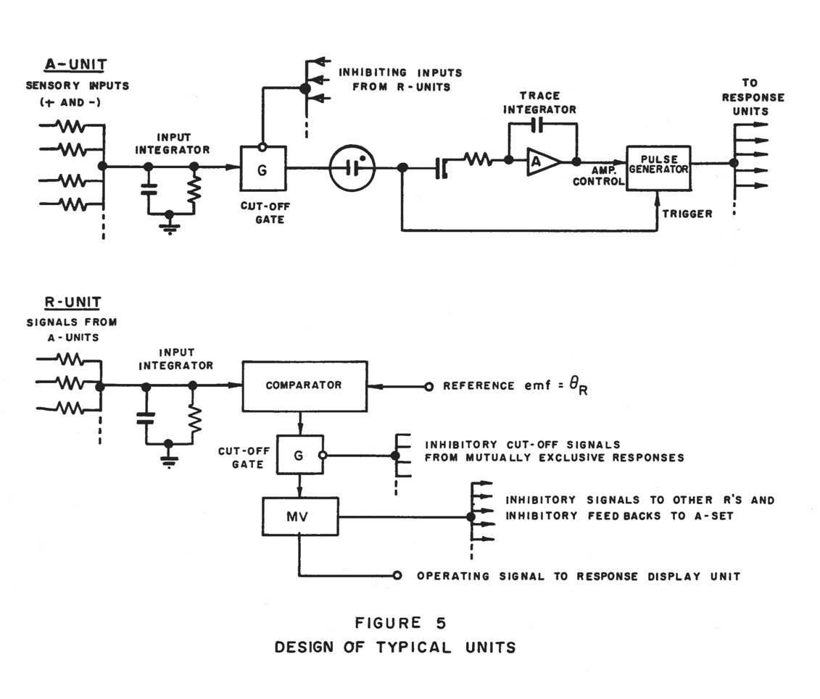
Build a brain - Evolution of the Perceptron
Eighty years later…
Perceptron
Rosenblatt, F. (1958). "The perceptron: A probabilistic model for information storage and organization in the brain". Psychological Review. 65 (6): 386–408
import numpy as np
class Perceptron:
def __init__(self, input_size, learning_rate=0.01, epochs=100):
self.weights = np.zeros(input_size + 1) # +1 for the bias term
self.learning_rate = learning_rate
self.epochs = epochs
def activation_function(self, x):
return 1 if x >= 0 else 0
def predict(self, x):
z = self.weights.T.dot(np.insert(x, 0, 1)) # Insert 1 for bias term
return self.activation_function(z)
def fit(self, X, y):
for epoch in range(self.epochs):
for xi, target in zip(X, y):
prediction = self.predict(xi)
self.weights[1:] += self.learning_rate * (target - prediction) * xi
self.weights[0] += self.learning_rate * (target - prediction) # Bias term
def evaluate(self, X, y):
predictions = [self.predict(xi) for xi in X]
accuracy = np.mean(predictions == y)
return accuracy
McCulloch, W; Pitts, W (1943). "A Logical Calculus of Ideas Immanent in Nervous Activity". Bulletin of Mathematical Biophysics. 5: 115–133
Rosenblatt, Frank (1957). "The Perceptron—a perceiving and recognizing automaton" (PDF). Report 85-460-1. Cornell Aeronautical Laboratory
ChatGPT 4o – “write a perceptron in python”

Slide 6
AI Trends
Large Language Model
What word comes next?
Learning from graphs
Does this person fit in my social network?
Variable length inputs and outputs
Simple neural network
Hidden layers
Deep Neural Networks
Brain Inspired Computing
Native AI at very low power
Vaswani, A., “Attention Is All You Need”, arXiv e-prints, 2017.
Kwei-Herng Lai, et al. 2020. Policy-GNN: Aggregation Optimization for Graph Neural Networks.(KDD '20).
Dr. Katherine Schuman
Wikipedia

Slide 7
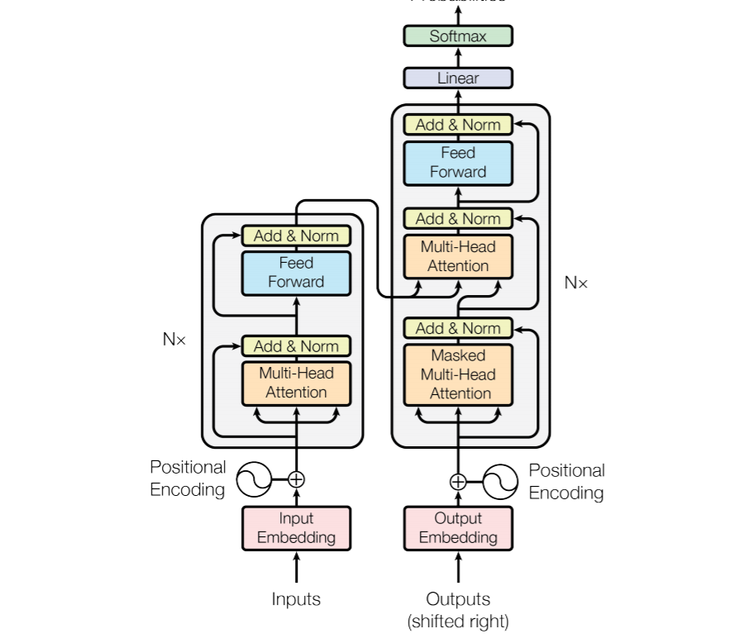
LLM – Encode language model using neural networks
A data driven language model
Novelty in the encoding, not the neural network
Minivan
Cat
Dog
Bear
Fox
The quick brown X jumped over the lazy dog.
Large Language Model
A model that can generate sentences
Vaswani, A., “Attention Is All You Need”, arXiv e-prints, 2017.

Slide 8
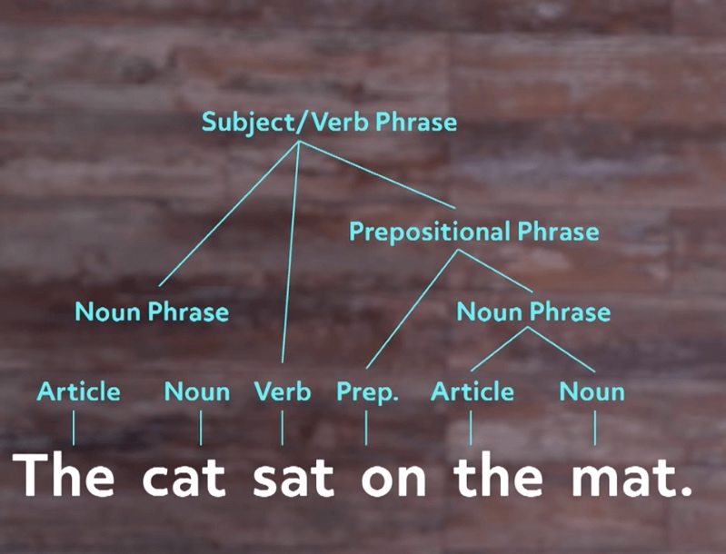
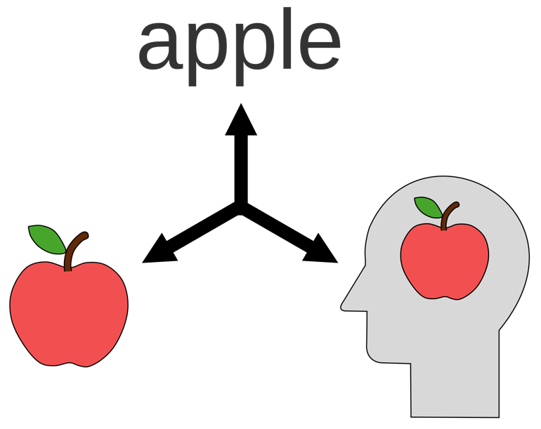

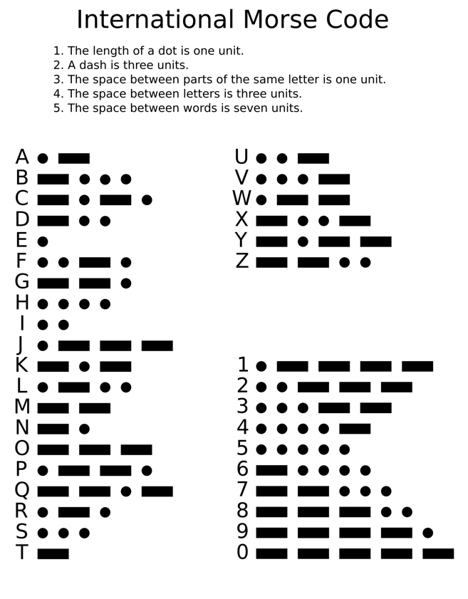

Human models of language
Human to human
Language
Syntax
Semantics
Encoded Human to human
Language
Spoken
Word
Written
Word
Printed
Word
Morse Code Signals

Slide 9

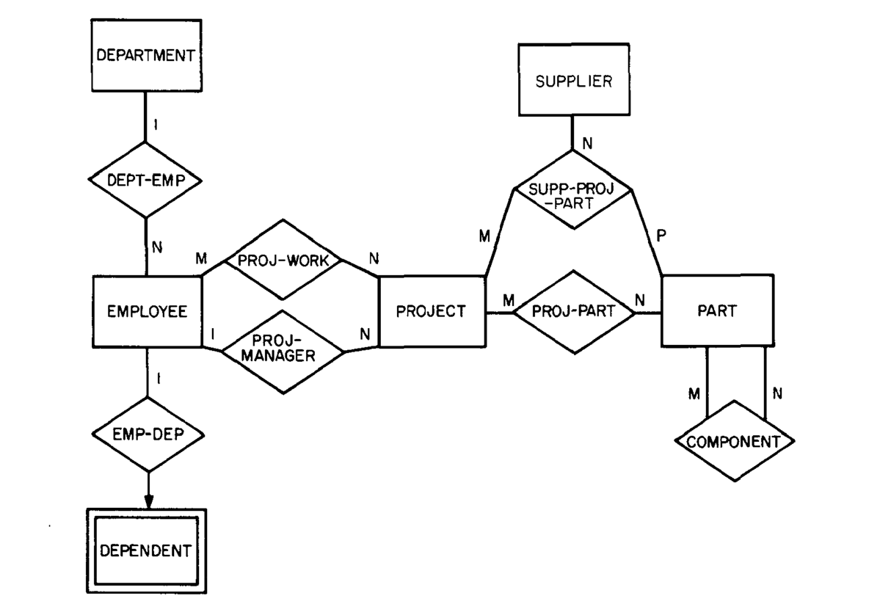


How to represent concepts as human’s do
Business Terms
Business Relationships
Factory – 9 months
Node
Business Terms
Entity Relationship Models
Peter Pin-Shan Chen. 1976. The entity-relationship model—toward a unified view of data. ACM Trans. Database Syst. 1, 1 (March 1976), 9–36.
Expert Systems
Meta Models
Rule-based Generative Model
IT System – 18+ months

Slide 10
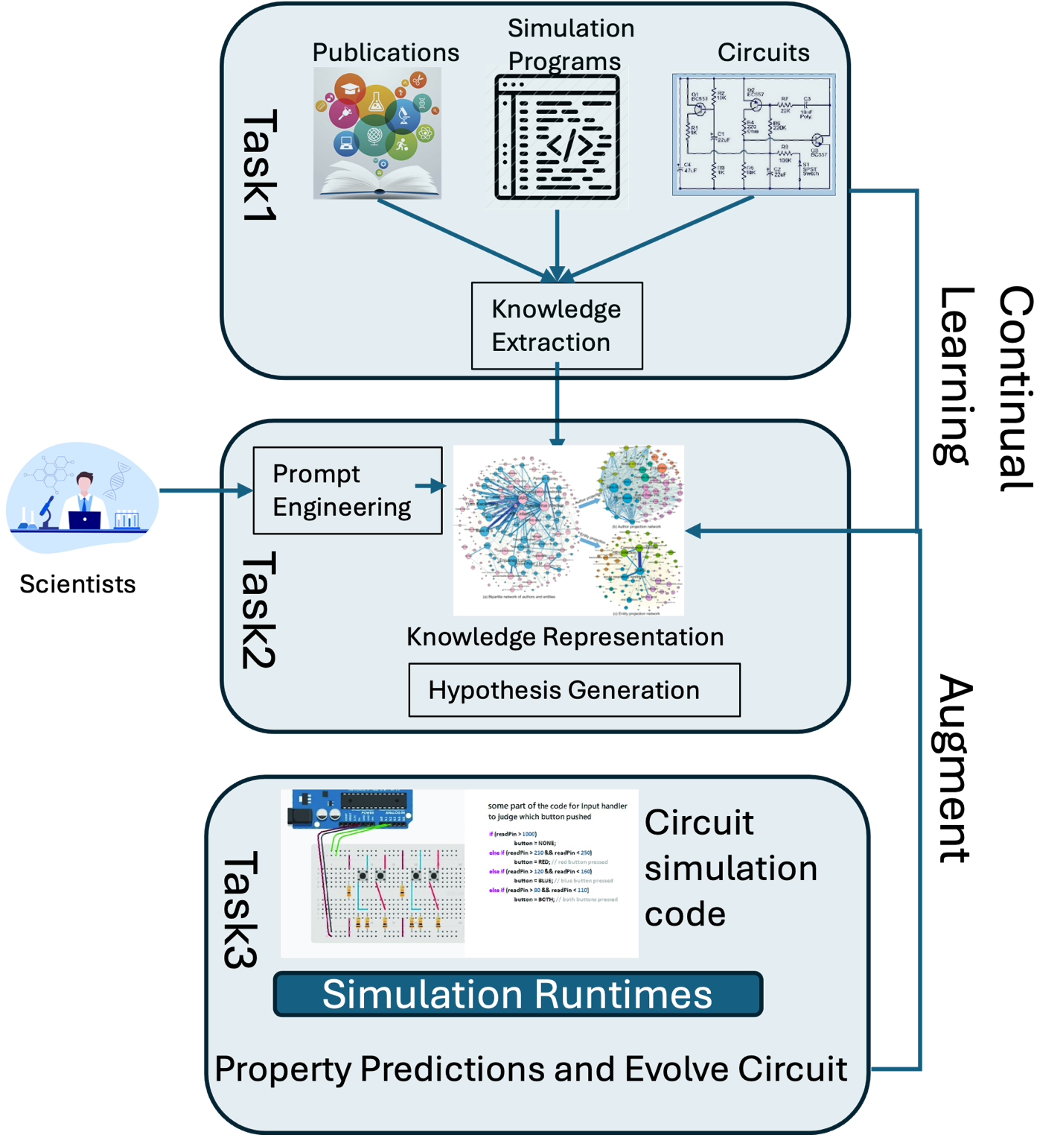

Artificial Intelligence and Knowledge Graphs to Accelerate Energy Efficient Computing (KNIGHT)
Use knowledge graphs to better understand neuromorphic computing potential
Extract knowledge from publications
Generate hypotheses
Simulate and evolve circuits

Slide 11
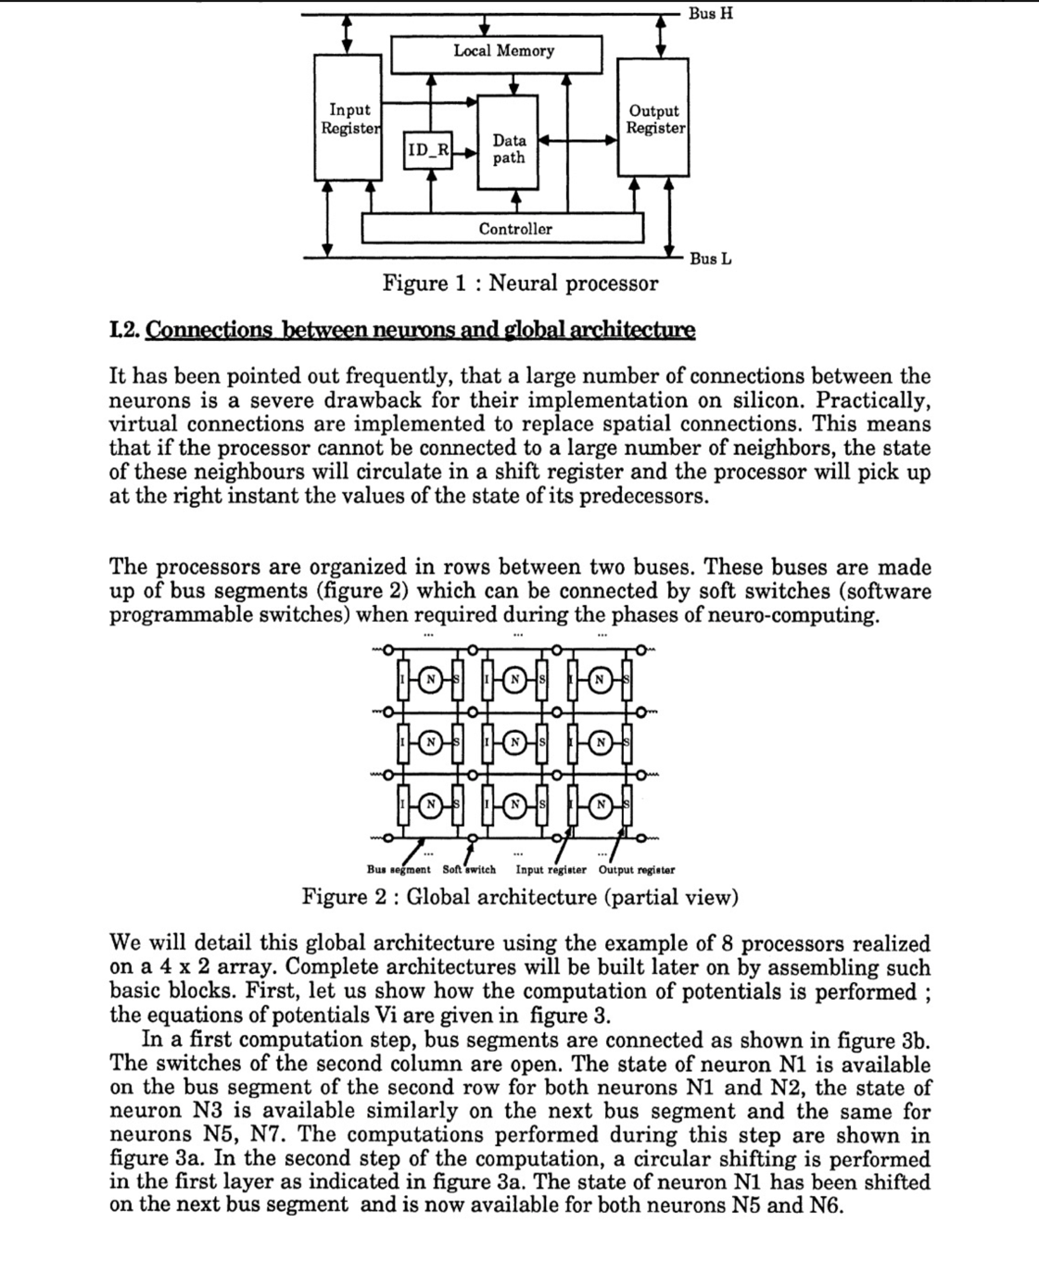
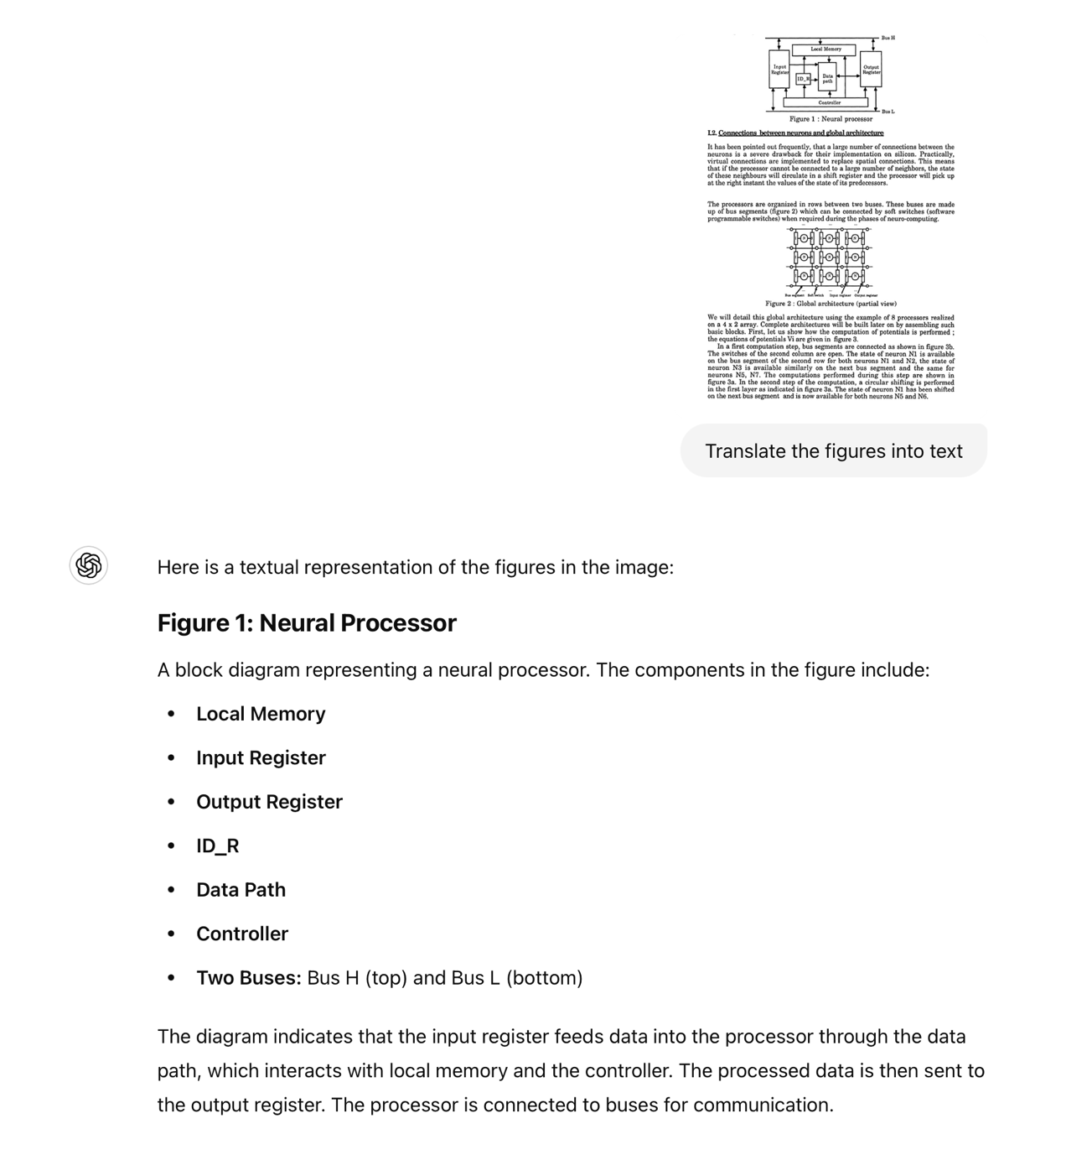
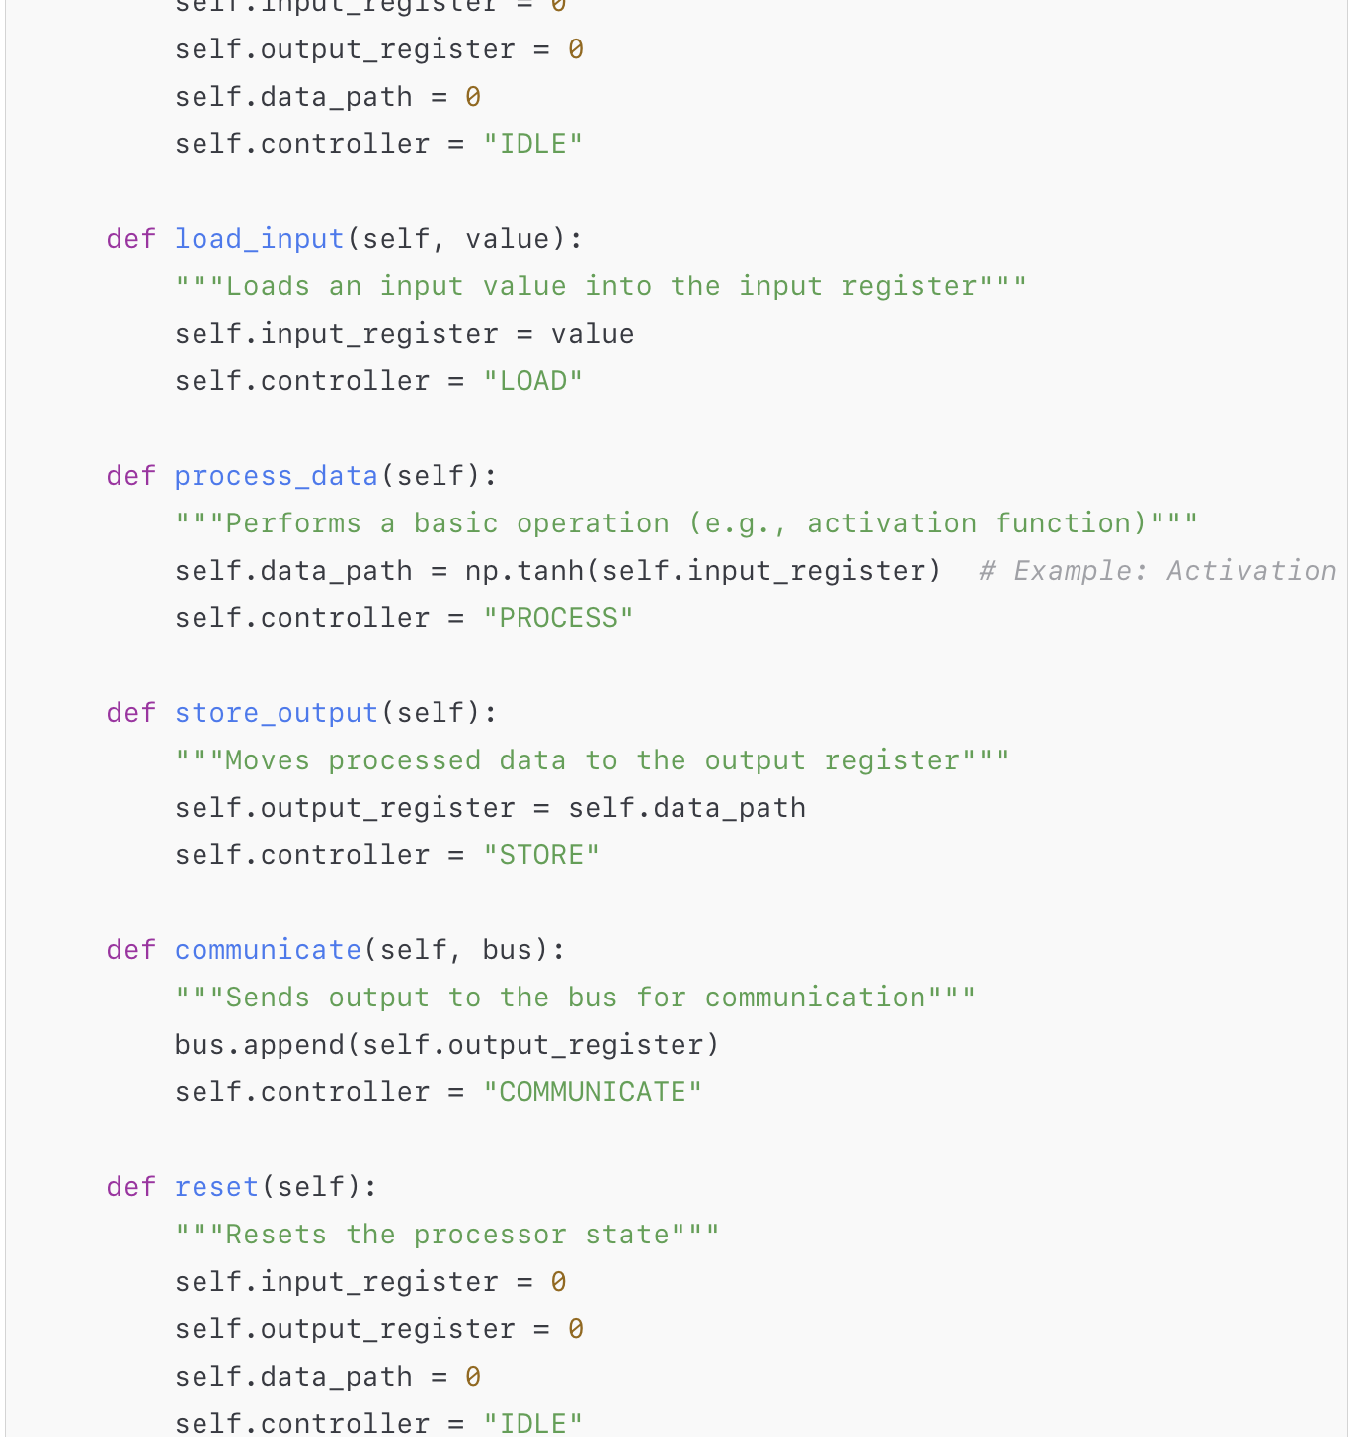
From paper to code using LLM
Random Neuromorphic Paper
ChatGPT 4o – Translate the figure to text
How to simulate the operation of the device in figure 1?
Ouali, J., Saucier, G. (1990). Fast Generation of Neuro-ASICs. In: International Neural Network Conference. Springer, Dordrecht. https://doi.org/10.1007/978-94-009-0643-3_4

Slide 12
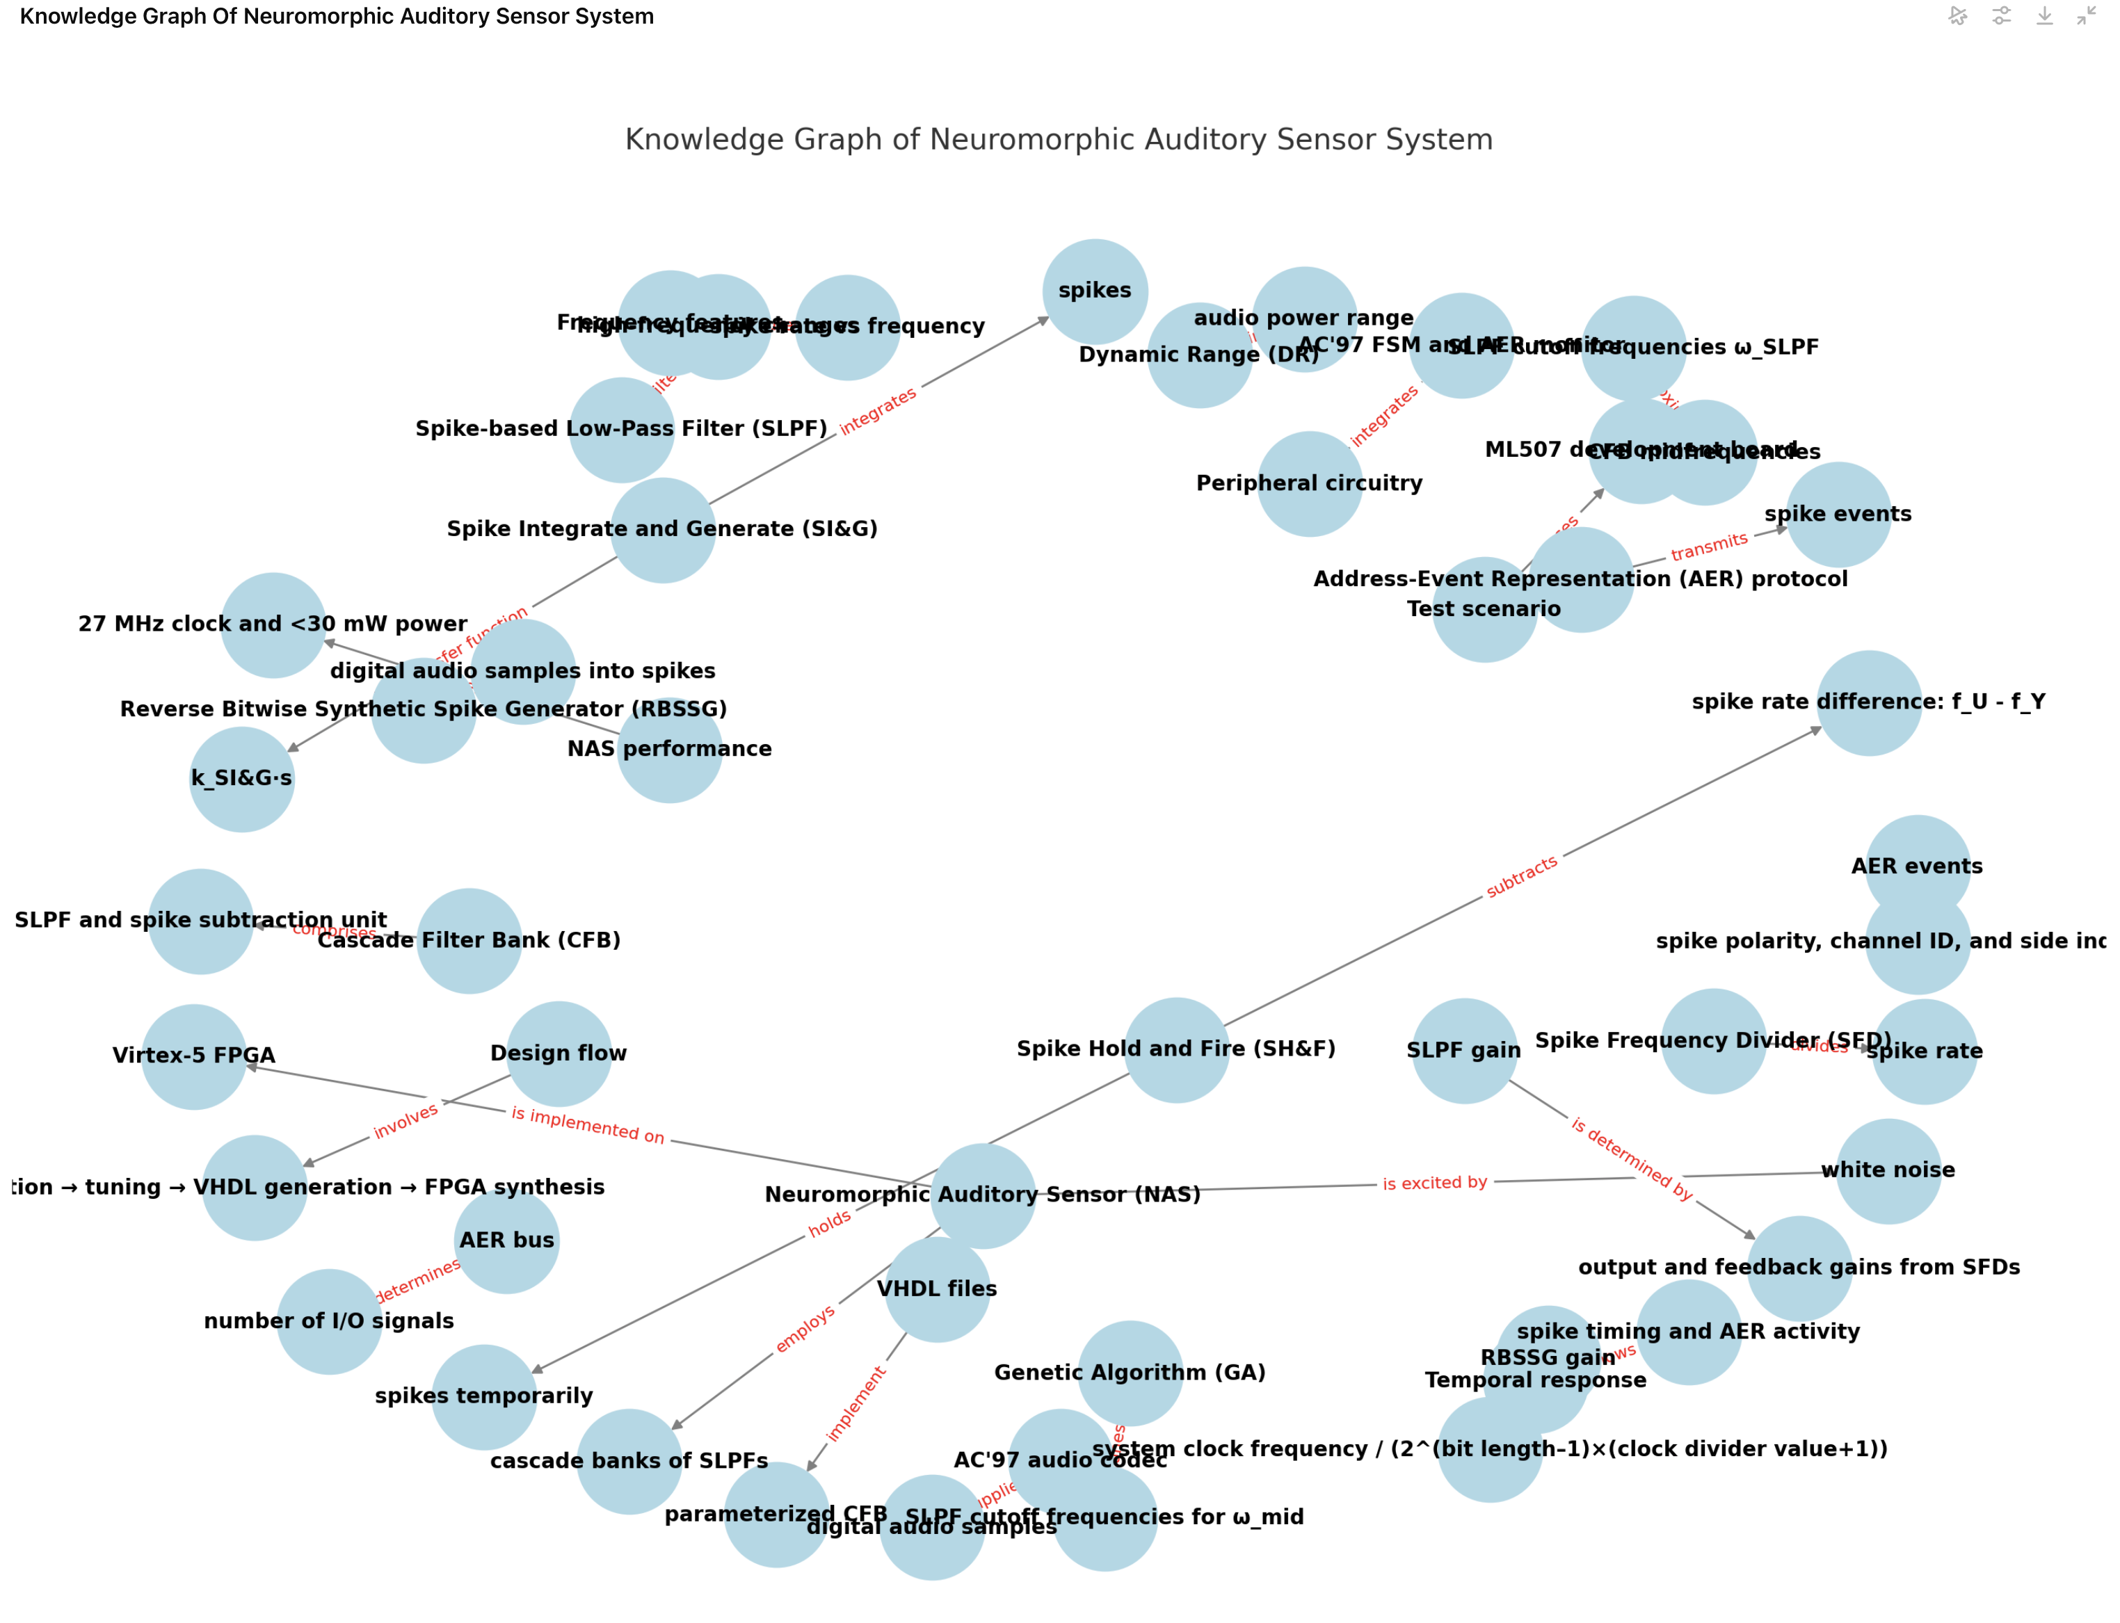

Slide 13
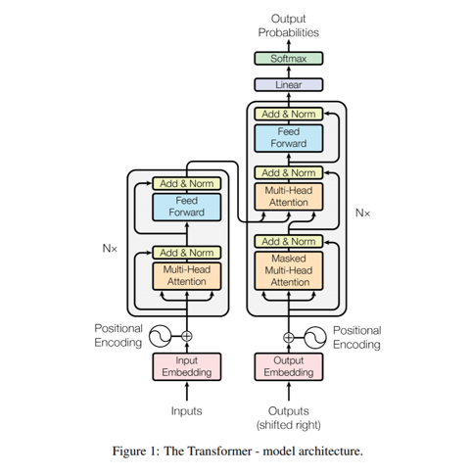
Knowledge Graph from 900K PubMed Covid abstracts
Abstract
The World Health Organization (WHO) declared COVID-19 (novel coronavirus) as a global pandemic in the middle of March 2020, after the disease spread to more than 150 countries and territories leading to tens of thousands of cases within a couple of months. To date, there are no effective pharmaceutical treatments available. As well as that, the novel vaccines have not yet been approved as establishing their efficacy will take time. This study aims to summarize the evidence regarding corticosteroids such as dexamethasone for the treatment of COVID-19. Electronic searches were conducted on 7 September 2020 on Google Scholar database, MEDLINE and PubMed. A further search was conducted on the World Health Organization’s COVID-19 research article database. The findings of recent investigations that proved, both, the in vitro and in vivo activity of corticosteroids against COVID-19 and other coronavirus-related pneumonia were discussed. Low doses of corticosteroids (dexamethasone) could reduce the mortality in patients with severe COVID-19 disease; however, they had no effect on the mortality rate of those patients with a mild form of the condition. Moreover, the liberal use of corticosteroids was not advocated for, as high doses of the drug can cause more harm than good.
Abstract
The World Health Organization (WHO) declared COVID-19 (novel coronavirus) as a global pandemic in the middle of March 2020, after the disease spread to more than 150 countries and territories leading to tens of thousands of cases within a couple of months. To date, there are no effective pharmaceutical treatments available. As well as that, the novel vaccines have not yet been approved as establishing their efficacy will take time. This study aims to summarize the evidence regarding corticosteroids such as dexamethasone for the treatment of COVID-19. Electronic searches were conducted on 7 September 2020 on Google Scholar database, MEDLINE and PubMed. A further search was conducted on the World Health Organization’s COVID-19 research article database. The findings of recent investigations that proved, both, the in vitro and in vivo activity of corticosteroids against COVID-19 and other coronavirus-related pneumonia were discussed. Low doses of corticosteroids (dexamethasone) could reduce the mortality in patients with severe COVID-19 disease; however, they had no effect on the mortality rate of those patients with a mild form of the condition. Moreover, the liberal use of corticosteroids was not advocated for, as high doses of the drug can cause more harm than good.
Abstract
The World Health Organization (WHO) declared COVID-19 (novel coronavirus) as a global pandemic in the middle of March 2020, after the disease spread to more than 150 countries and territories leading to tens of thousands of cases within a couple of months. To date, there are no effective pharmaceutical treatments available. As well as that, the novel vaccines have not yet been approved as establishing their efficacy will take time. This study aims to summarize the evidence regarding corticosteroids such as dexamethasone for the treatment of COVID-19. Electronic searches were conducted on 7 September 2020 on Google Scholar database, MEDLINE and PubMed. A further search was conducted on the World Health Organization’s COVID-19 research article database. The findings of recent investigations that proved, both, the in vitro and in vivo activity of corticosteroids against COVID-19 and other coronavirus-related pneumonia were discussed. Low doses of corticosteroids (dexamethasone) could reduce the mortality in patients with severe COVID-19 disease; however, they had no effect on the mortality rate of those patients with a mild form of the condition. Moreover, the liberal use of corticosteroids was not advocated for, as high doses of the drug can cause more harm than good.
Hypothesis Prediction using Large Language Models and Knowledge Graph Embeddings
Citation 1
Citation 2
Citation 3
cites
Dexamethasone treatment covid
Abstract
Abstract
The World Health Organization (WHO) declared COVID-19 (novel coronavirus) as a global pandemic in the middle of March 2020, after the disease spread to more than 150 countries and territories leading to tens of thousands of cases within a couple of months. To date, there are no effective pharmaceutical treatments available. As well as that, the novel vaccines have not yet been approved as establishing their efficacy will take time. This study aims to summarize the evidence regarding corticosteroids such as dexamethasone for the treatment of COVID-19. Electronic searches were conducted on 7 September 2020 on Google Scholar database, MEDLINE and PubMed. A further search was conducted on the World Health Organization’s COVID-19 research article database. The findings of recent investigations that proved, both, the in vitro and in vivo activity of corticosteroids against COVID-19 and other coronavirus-related pneumonia were discussed. Low doses of corticosteroids (dexamethasone) could reduce the mortality in patients with severe COVID-19 disease; however, they had no effect on the mortality rate of those patients with a mild form of the condition. Moreover, the liberal use of corticosteroids was not advocated for, as high doses of the drug can cause more harm than good.
dexamethasone
COVID-19
treatment
Citation 1
Citation 2
Citation 3
Predicate
Abstract
Ensemble
dexamethasone
treatment
COVID-19
Large
Language
Model
Embedding
…
…

Slide 14
The model and results
LLM Encoded Data
Training
Prediction
Validation
Dexamethasone
Dexamethasone
Dexamethasone
Treats
Treats
Treats
COVID-19
COVID-19
COVID-19
Treatment
COVID-19
Triggers
Asthma
Triggers
Asthma
Triggers
Asthma
Dexamethasone
4
4
4
…
…
…
5
5
5
6
6
6
Knowledge Graph Embedding (KGE)
66K
62
66K
How many of these 10 prediction are in the validation set? In our 660K predictions, 93% of the 128K ground truths are appearing as rank-1 prediction
Predict 660K out of 270+B Possible Predictions – Ten predictions for each of the 66K entities
Prediction | Head | Relationship | Tail
1st | N2 | R32 | N6
2nd | N2 | R21 | N3
Model | Hits@1 | Hits@5 | Hits@10
Baseline KGE | 0.139 | 0.387 | 0.509
ORNL Model | 0.931 | 0.967 | 0.974
…
10th | N4 | R58 | N6
Zheng, Da, et al. "Dgl-ke: Training knowledge graph embeddings at scale." Proceedings of the 43rd International ACM SIGIR Conference on Research and Development in Information Retrieval. 2020.

Slide 15
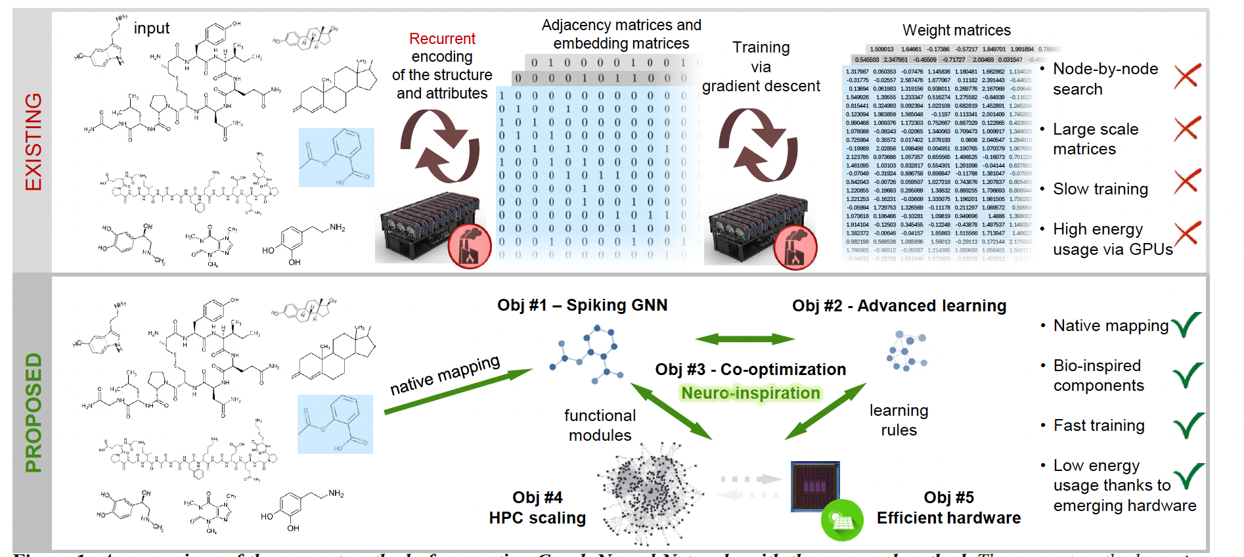
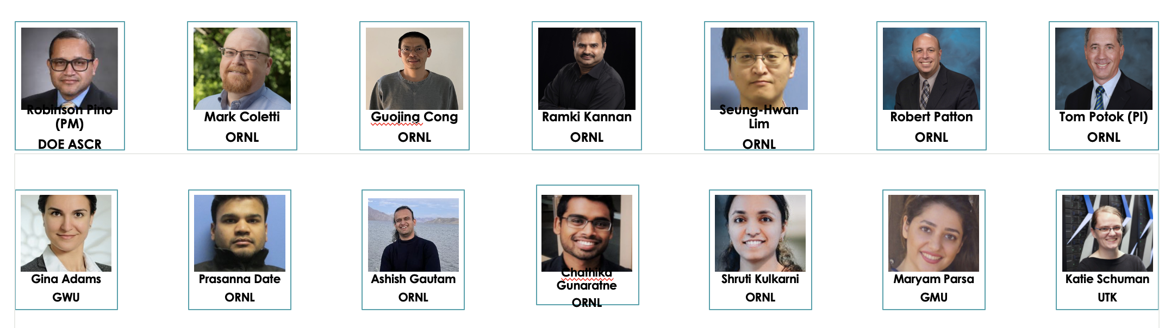
ENGAGE: (E)nergy-efficient (N)ovel Al(g)orithms and (A)rchitectures for (G)raph L(e)arning
GNNs in Science:
Powerful for modeling complex data (e.g., molecules, networks) in scientific research.
Boosts accuracy in drug discovery, environmental science, etc.
Challenges:
Growing model sizes increase energy demands and cause over-smoothing.
Solution - SNNs:
Develop energy-efficient, asynchronous graph learning models with Spiking Neural Networks (SNNs).
Avoids over-smoothing, improving learning efficiency.
Advanced Learning:
Use Spike Timing-Dependent Plasticity (STDP) for efficient learning.
Minimize costly communication in large graph instances.
Co-design & Simulations:
Optimize algorithms with hardware co-design (e.g., memristors, FGMOS transistors).
Use simulators to enhance performance and energy efficiency.
Scalability & Validation:
Scale simulations on high-performance computing systems.
Validate with real hardware, comparing with traditional GNNs.
A comparison of the current method of generating Graph Neural Networks with the proposed method.

Slide 16
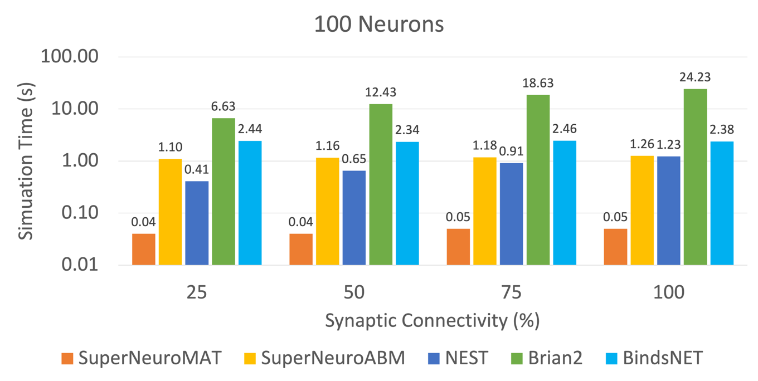


SuperNeuro: An Accelerated Neuromorphic Computing Simulator
Science
Impact
Performance
Neuromorphic architectures have the potential to increase computing power and efficiency, as well as advance AI applications. SuperNeuro provides an indispensable capability for this effort via the leveraging of GPU computing to provide superior performance for neuroscience, increased adaptability, spiking neural networks (SNNs), and general-purpose computing workloads.
Simulating 100 neurons on 5 neuromorphic simulators with 4 different synaptic connectivites. SuperNeuroMAT performs 300 times faster than other neuromorphic simulators.
Simulating 100 neurons on 5 neuromorphic simulators with 4 different synaptic connectivites. SuperNeuroMAT performs 300 times faster than other neuromorphic simulators.
PI(s)/Facility Lead(s): Prasanna Date, Chathika Gunaratne, Shruti Kulkarni, Robert Patton, Mark Coletti, and Thomas Potok
Collaborating Institutions: Oak Ridge National Laboratory
ASCR Program: N/A
ASCR PM: Robinson Pino
Publication(s) for this work: Date, Prasanna, Chathika Gunaratne, Shruti R. Kulkarni, Robert Patton, Mark Coletti, and Thomas Potok. "SuperNeuro: A Fast and Scalable Simulator for Neuromorphic Computing." In Proceedings of the 2023 International Conference on Neuromorphic Systems, pp. 1-4. 2023.
Notes:
LOCAL LAB POC: Prasanna Date, Computer Science & Mathematics Division, ORNL
TALKING POINTS:
ORNL scientists developed SuperNeuro, the world’s fastest simulator for neuromorphic computing
SuperNeuro uses two novel approaches for simulating neuromorphic computing operations: (1) Matrix Computation Approach (MAT); and (2) Agent-based Modeling (ABM) Approach
Under the MAT approach, SuperNeuro supports homogeneous simulations (all neurons and synapses are of the same type), built-in learning algorithm, CPU execution, and is suited for fast and scalable performance on desktop workstations
Under the ABM approach, SuperNeuro supports heterogeneous simulations (neurons and synapses can be of different types) and GPU execution)
METADATA:
Name of the associated awarded project: ASCEND
PI name(s): Thomas Potok (ORNL)
Name of the program manager: Robinson Pino
CITATIONS:
Date, Prasanna, Chathika Gunaratne, Shruti R. Kulkarni, Robert Patton, Mark Coletti, and Thomas Potok. "SuperNeuro: A Fast and Scalable Simulator for Neuromorphic Computing." In Proceedings of the 2023 International Conference on Neuromorphic Systems, pp. 1-4. 2023.
AWARDS:
2023 R&D 100 Award in Software/Services Category
REPRODUCIBILITY:
N/A
BACKGROUND AND CONTEXT INFORMATION:
You may include further background or other information that would be helpful in understanding and delivering the full impact of this research.

Slide 17
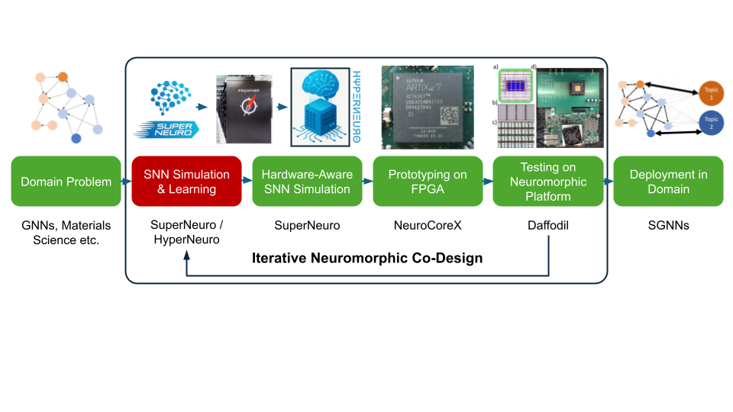
DOE AI for Science ENGAGE
Run on 8,112 Frontier supercomputer nodes.
Simulates 33 billion neurons and 33 trillion synapses.
Completed in 78.36 seconds, using 3.5 PB memory.
Achieved 65% parallel efficiency.

Slide 18

AI and the future
Now is a great time to study AI!
Challenges that need to be solved
  AI’s energy usage
  Complexity – how to understand large models are doing
  Expense to develop new models
  How to keep them safe and trustworthy

Slide 19
Contact Information:
Dr. Thomas Potok
Data and Artificial Intelligence Systems Section Lead
Computer Science and Mathematics Division
Oak Ridge National Laboratory
865-574-0834
potokte@ornl.gov

